Slide 1
Combinational Logic Analysis
Part 2
Course : CPEN6265010 Digital System
Effective Period : September 2025

Slide 2
Related LO
Learning Objectives
LO1: Analyze and Design Combinational Logic Circuits.

Slide 3
Outlines
The Universal Property of NAND and NOR Gates
Combinational Logic Using NAND and NOR Gates
Pulse Waveform Operation

Slide 4
The Universal Property of NAND and NOR Gates
NAND gates are sometimes called universal gates because they can be used to produce the other basic Boolean functions.
A
A
A
AB
B
Inverter
AND gate
A
A
A + B
A + B
B
B
OR gate
NOR gate

Slide 5
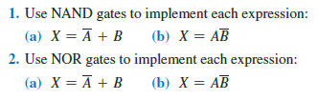
The Universal Property of NAND and NOR Gates
NOR gates are also universal gates and can form all of the basic gates.
A
A
A
A + B
B
Inverter
OR gate
A
A
AB
AB
B
B
AND gate
NAND gate

Slide 6
Combinational Logic Using NAND and NOR Gates
Recall from DeMorgan’s theorem that AB = A + B. By using equivalent symbols, it is simpler to read the logic of SOP forms. The earlier example shows the idea:
A
C
X =
A
C
+
A
B
A
B
The logic is easy to read if you (mentally) cancel the two connected bubbles on a line.

Slide 7
Combinational Logic Using NAND and NOR Gates
Alternatively, DeMorgan’s theorem can be written as A + B = A B. By using equivalent symbols, it is simpler to read the logic of POS forms. For example,
A
B
X =
(A + B)(A + C)
A
C
Again, the logic is easy to read if you cancel the two connected bubbles on a line.

Slide 8
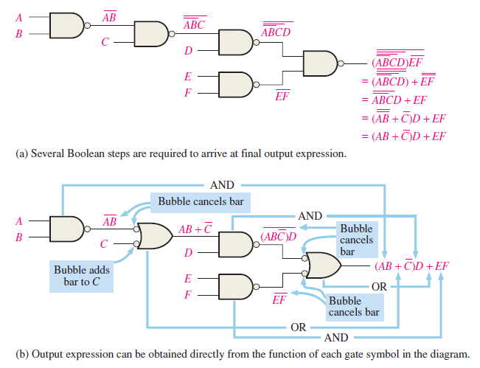
Combinational Logic Using NAND and NOR Gates

Slide 9
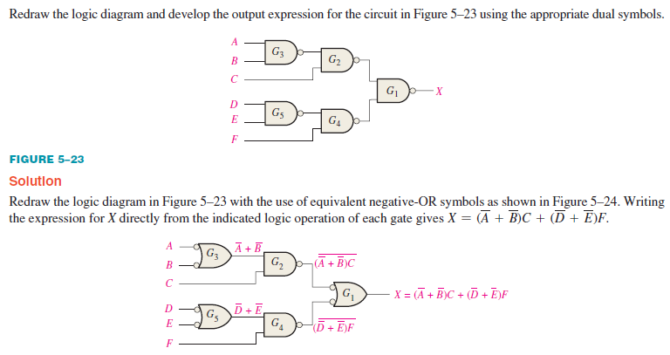
Combinational Logic Using NAND and NOR Gates

Slide 10
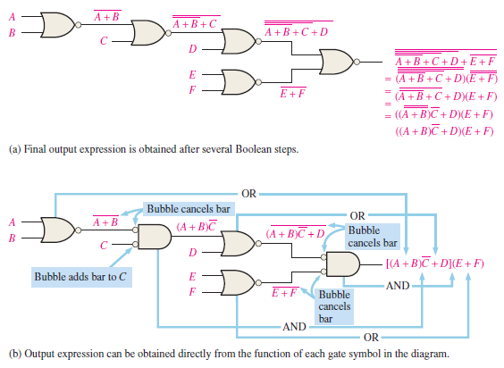
Combinational Logic Using NAND and NOR Gates

Slide 11
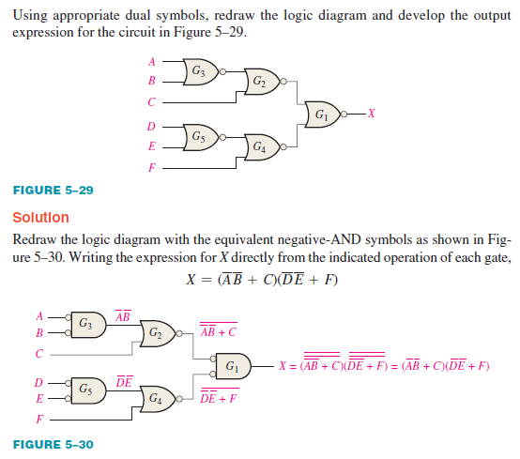
Combinational Logic Using NAND and NOR Gates

Slide 12
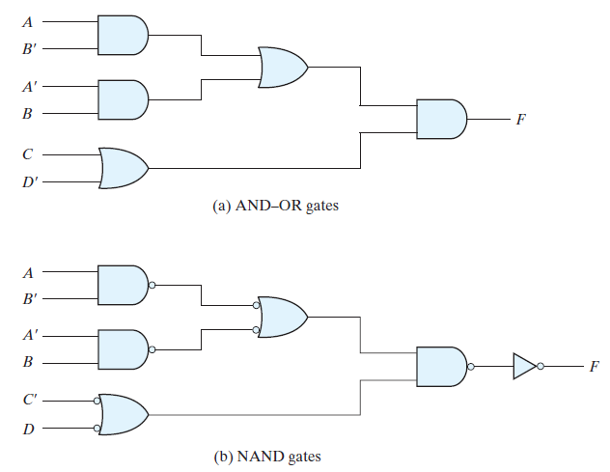
Combinational Logic Using NAND and NOR Gates
Implement the multilevel Boolean function using NAND gates.
F = (AB’ + A’B) (C + D’)

Slide 13
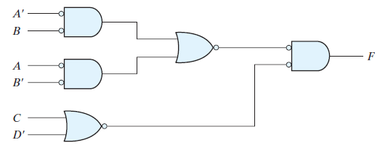
Combinational Logic Using NAND and NOR Gates
Implement the multilevel Boolean function using NOR gates.
F = (AB’ + A’B) (C + D’)

Slide 14
Combinational Logic Using NAND and NOR Gates
For basic combinational logic circuits, the Karnaugh map can be read and the circuit drawn as a minimum SOP.
Example
A Karnaugh map is drawn from a truth table. Read the minimum SOP expression and draw the circuit.
Solution
1. Group the 1’s into two overlapping groups as indicated.
Read each group by eliminating any variable that changes across a boundary.
B changes across this boundary
The vertical group is read A C.
C changes across this boundary
The horizontal group is read AB.
The circuit is on the next slide:

Slide 15
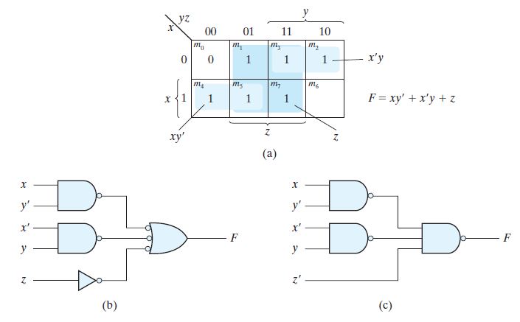
Combinational Logic Using NAND and NOR Gates
Implement the following Boolean function using NAND gates.
F(x,y,z) = (1, 2, 3, 4, 5, 7)

Slide 16
Combinational Logic Using NAND and NOR Gates
Example
Convert the circuit in the previous example to one that uses only NAND gates.
Solution
Recall from Boolean algebra that double inversion cancels. By adding inverting bubbles to above circuit, it is easily converted to NAND gates:
A
C
X =
A
C
+
A
B
A
B

Slide 17
Pulse Waveform Operation
For combinational circuits with pulsed inputs, the output can be predicted by developing intermediate outputs and combining the result. For example, the circuit shown can be analyzed at the outputs of the OR gates:
A
A
G₁
B
B
G₃
C
C
D
G₂
D
G₁
G₂
G₃

Slide 18
Pulse Waveform Operation
Alternatively, you can develop the truth table for the circuit and enter 0’s and 1’s on the waveforms. Then read the output from the table.
Inputs
Output
A B C D
X
0 0 0 0
0
A
G₁
0 0 0 1
1
B
0 0 1 0
1
G₃
0 0 1 1
1
C
0 1 0 0
0
G₂
0 1 0 1
1
D
0 1 1 0
1
A
0 1 0 1 0 1 0 1 0 1
0 1 1 1
1
1 0 0 0
0
B
0 1 1 0 0 1 1 0 0 0
1 0 0 1
0
1 0 1 0
0
C
0 0 0 1 1 1 1 0 0 0
1 0 1 1
0
0 0 0 0 0 0 0 1 1 0
1 1 0 0
0
D
1 1 0 1
1
G₃
0 0 0 0 1 1 1 0 1 0
1 1 1 0
1
1 1 1 1
1

Slide 19
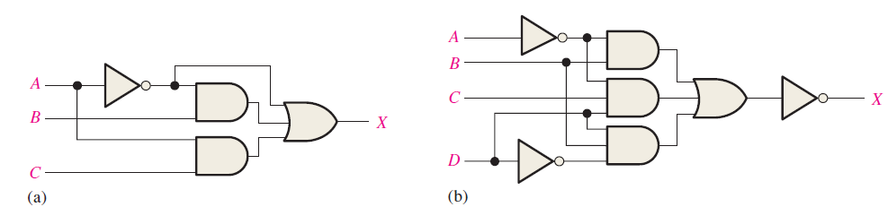
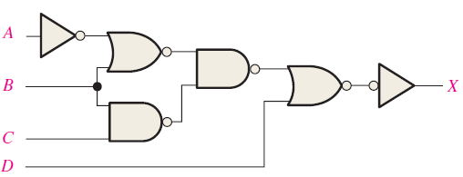
Exercise
Draw the ANSI distinctive shape logic diagram for a 4-wide, 3-input AND-OR-Invert circuit. Also draw the ANSI standard rectangular outline symbol.
Write the output expression for each circuit
Write the output expression for each circuit as it appears in next figure and then change each circuit to an equivalent AND-OR configuration.

Slide 20
References
Null, Linda (2024). "The essentials of computer organization and architecture". 6th edition. Jones & Bartlett Learning, Burlington, Massachusetts. ISBN: 9781284259438..
Thomas L. Floyd. (2014). “Digital Fundamentals”. 11th Edition. Prentice Hall. New Jersey. ISBN: 978-0132737968.
Combinational Logic circuits: https://www.electronics-tutorials.ws/combination/comb_1.html
Combinational logic design: https://www.javatpoint.com/combinational-logic-circuits-in-digital-electronics

